Slide 1

Customer Lifetime Value Analysis
By Harshada Pujari, Virti Sheth, Jayesh Zambre, Shivanshi Tiwari

Slide 2
Table Of Content
OVERVIEW
INTRODUCTION
DATA PREPARATION/ CLEANING
EXPLORATORY DATA ANALYSIS
CUSTOMER PROFILING
CUSTOMER LIFETIME VALUE
COMPETITOR ANALYSIS
CONCLUSION AND RECOMMENDATION

Slide 3

Overview of Jibu
Jibu is a for-profit social enterprise started in 2012, by Randy and Galen Welsch
Main Products: Purified drinking water, LPG gas, fortified porridge
Area of Operation: Rwanda, Uganda, Kenya, Tanzania, DR Congo, Burundi, Zambia, and Ghana
Hybrid model, offering franchises that both generate income and drive positive social impact. Jibu equips franchises with capital, training, and support
Notes:
Nothing is more essential to life than clean drinking water. Where it’s in short supply—as in much of Africa and other developing regions—there’s opportunity for promoting good health, improving livelihoods, and making money. Jibu seeks to achieve all three through its franchises that treat, package, and distribute affordable water in the major cities of East Africa. For Jibu, selling water is ultimately a means to the end of spreading economic opportunity for the continent’s aspiring entrepreneurs.
We have explored total of 155 franchises including countries like Rwanda having 60, Uganda and Kenya having 45 and 11 being in Goma

Slide 4
Project Goal
Analyze Customer Lifetime Value: Evaluate the long-term value of franchises for Jibu
Informed Strategy Development: Utilize CLV insights to enhance marketing strategies, customer satisfaction, and boost franchise performance
Market Research and Competitor Analysis: To identify market trends, opportunities, and threats, for Jibu's competitive positioning

Slide 5
Data Description
Meters Reading
Franchise Name, Country, Water produced in liters, Month and year of production
Converted column names to lowercase
Countries: Kenya, Rwanda, Uganda and Goma
Considered years 2021, 2022, 2023 for calculating Recency, Frequency and Monetary value
Exclude negative water production values
Total 4367 records after cleaning

Slide 6
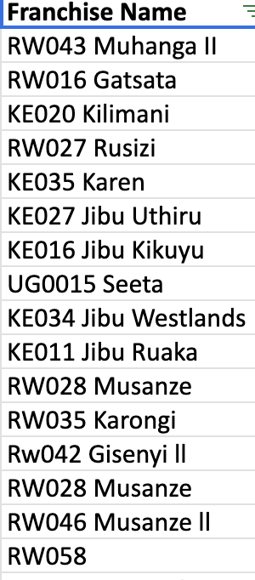
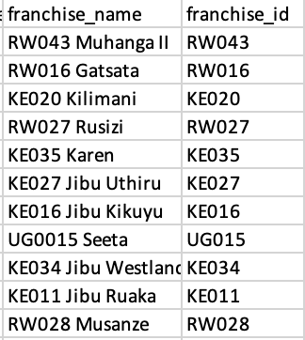
Data Description
Health Data
Franchise Name Country, Hygiene Audit Score, P&Q Audit Score, Target Achieved for water produced, LPG ad Porridge, Total Sales, Total Profit and Loss, Total Expenses
The 'Franchise Name' column from the first image was split into two separate columns, 'franchise_name' and 'franchise_id', to distinctly identify each franchise by its ID and name
Rigorously cleaned the data by mapping with Meter Reading and BOJ files manually

Slide 7
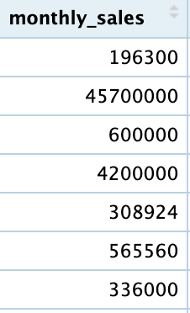
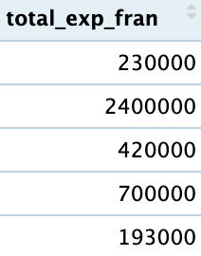
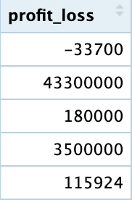
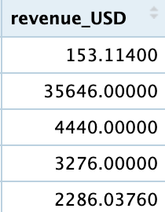
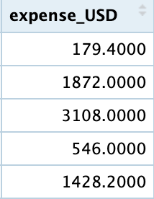
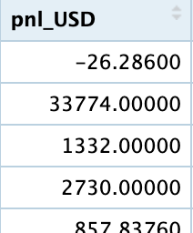
Data Cleaning & Preparation
Health Data
Excluded records with zero revenue because of data discrepancies
Converted 'monthly_sales', 'total_exp_fran', and 'profit_loss' into USD to standardized the comparison and analysis
Total 1058 records after cleaning

Slide 8
Data Cleaning & Preparation
BOJ Score
mWater Site ID > Name, P.1 Quality, P.2 Sales, P.3 Customer Experience, BOJ Total Score
Converted mWater Site ID > Name to Franchise_ID and Franchise_name and mapped it with Monthly meter reading and Franchise Health data
Consolidated the sheets for Kenya, Goma, Uganda and Rwanda into one file- BOJ_Consolidated
Total 124 franchises records over 4 countries after consolidation

Slide 9
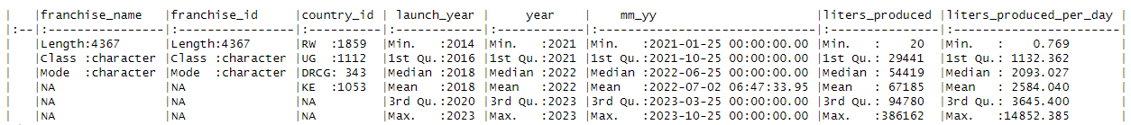
Exploratory Data Analysis - Monthly Meter Reading
Monthly Meter Reading:
Data Summary: The image provides summary statistics for water production across franchises, indicating significant variability in monthly production volumes and daily production rates
Production Variance: There's a vast range in production volumes, from as little as 20 liters to as much as 386,162 liters monthly, with an average production of 67,185 liters
Time-Stamped Data: The data spans from 2021 to 2023, allowing for temporal analysis of water production trends and operational efficiency among franchises

Slide 10
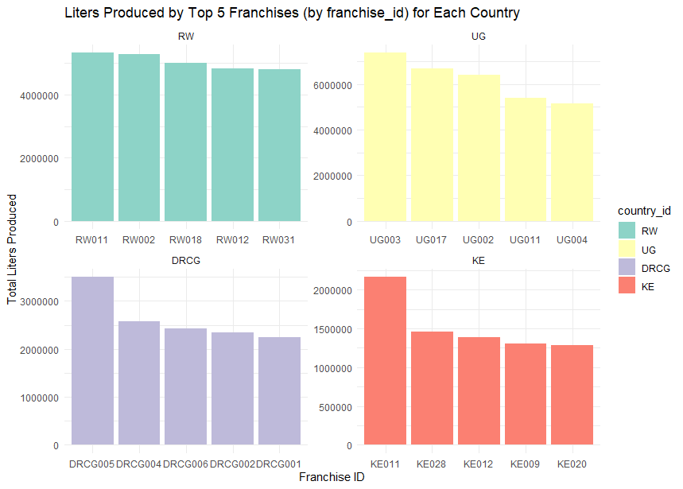
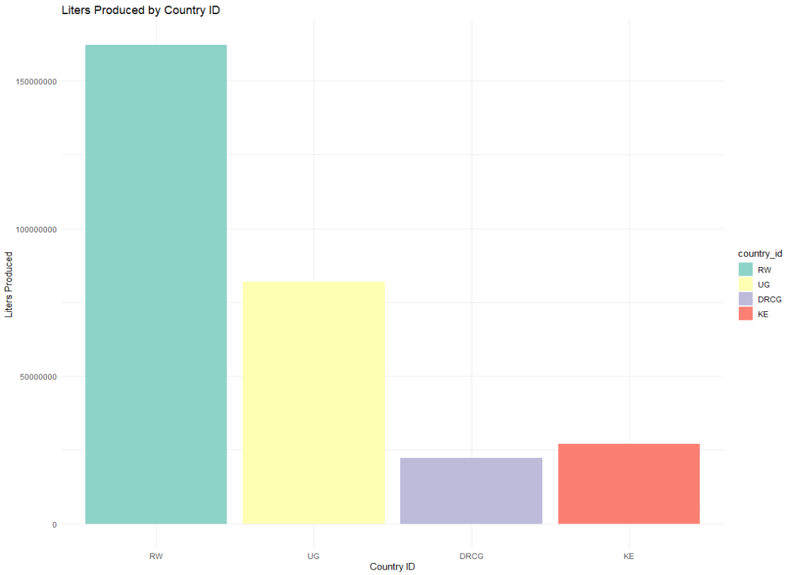
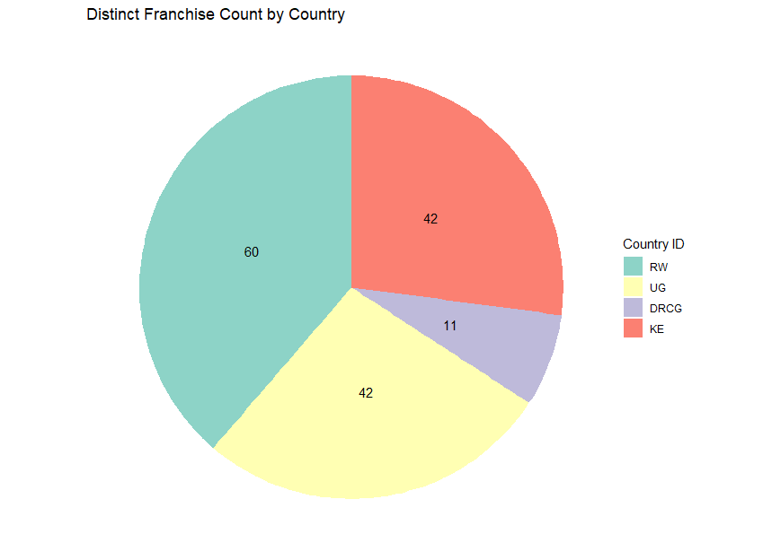
Exploratory Data Analysis - Monthly Meter Reading
Franchise: Rwanda has the highest number of franchises, followed by Uganda, Kenya and Goma has 11 franchises
Production: Rwanda also has the highest monthly liters produced followed by Uganda, Goma and then Kenya
Performances: The top 5 franchises in each country produce the highest liters of water per month are RW011, UG003, DRCG005 and KE011

Slide 11
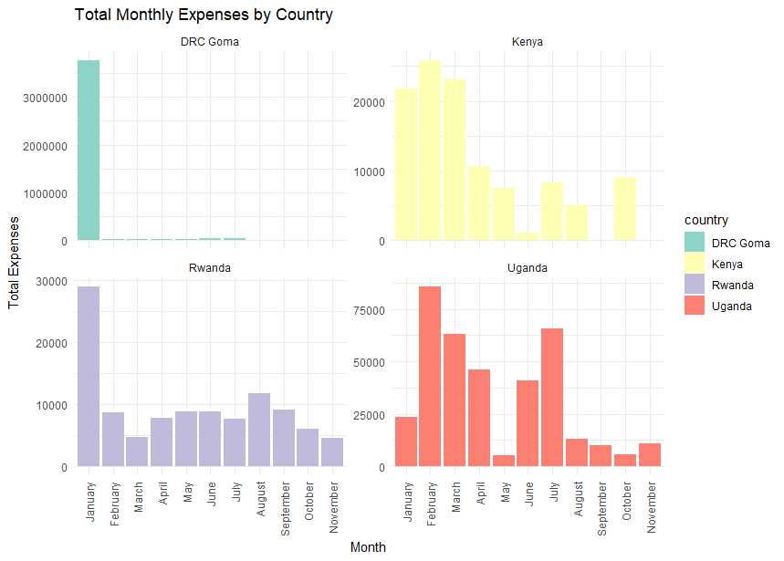
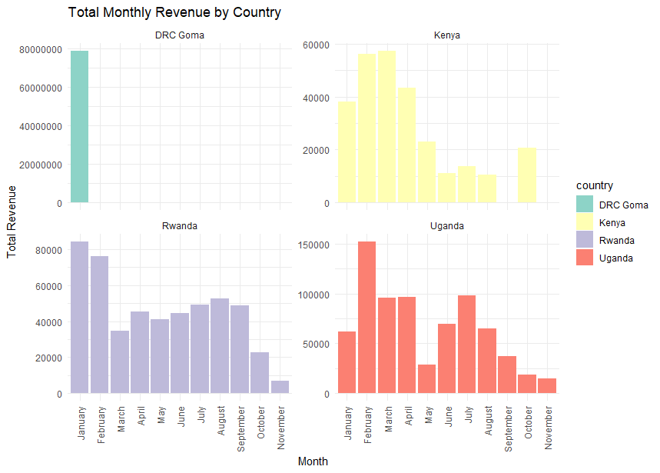
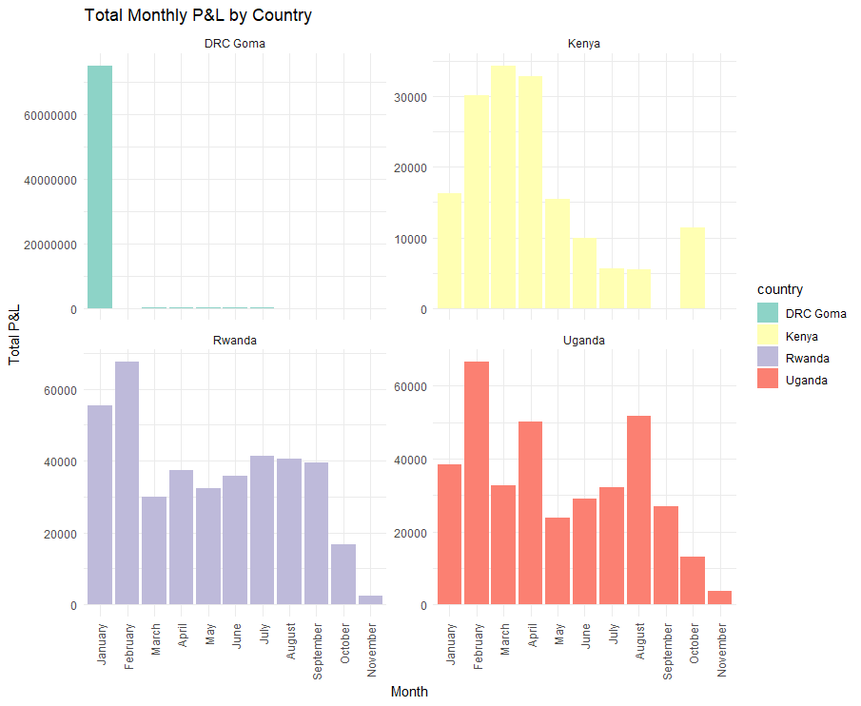
Exploratory Data Analysis - Health Data
Revenue Insights: Revenue graph reveals January revenue spikes, especially in Goma, indicating seasonal sales patterns
Expenses Overview: Expense graph shows varying monthly expenses, with Goma's January surge and Kenya's mid-year peak
Profit Analysis: P&L graph depicts steady profitability across countries, with some fluctuations suggesting market and operational influences

Slide 12
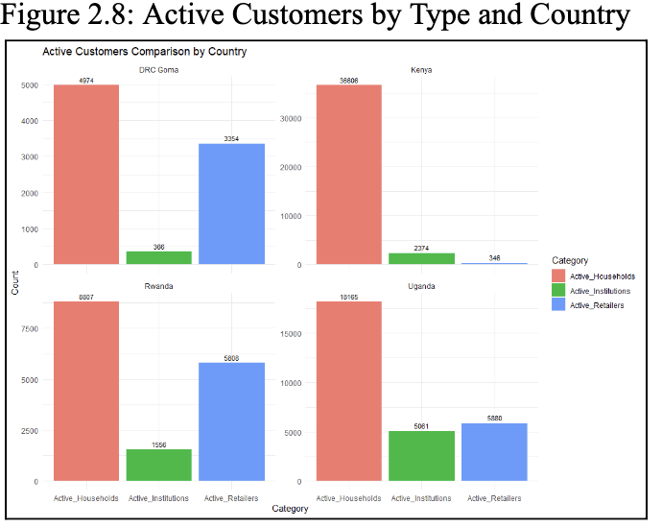
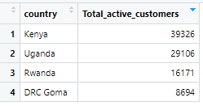
Exploratory Data Analysis - Health Data
Customer Distribution by Type: Highlights customer base composition in four countries, with households being the largest segment in each
Country Comparison: Summarizes the total active customers by country, showing Kenya at the top
Customer Type Trend: Indicates a consistent trend where households form the majority of the customer base across all countries, with retailers and institutions making up the rest

Slide 13
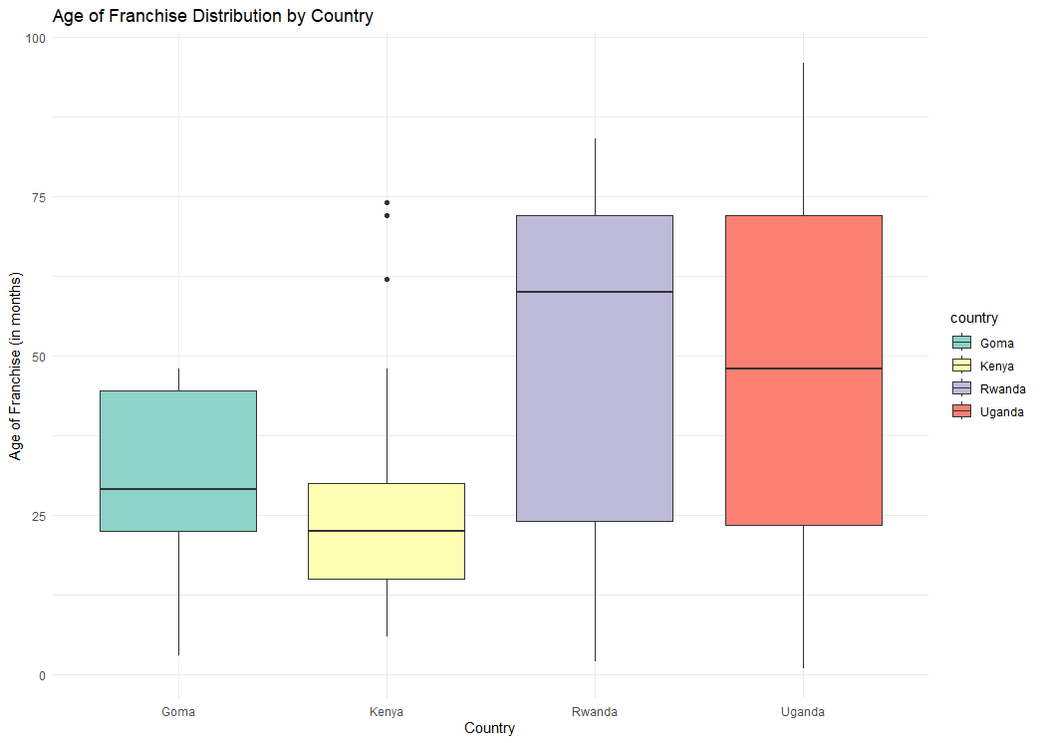
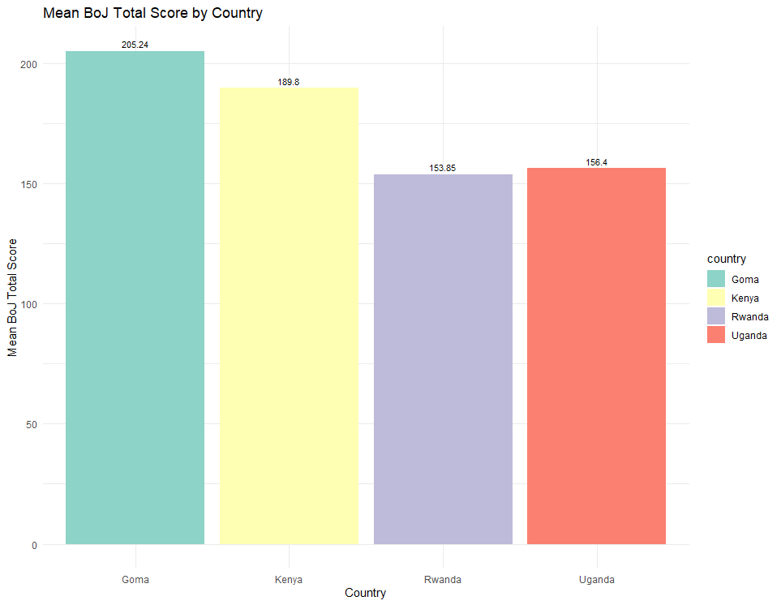
BOJ Score Data
Franchise Age: Rwanda's franchises are the oldest on average, with Kenya's being newer, signaling market maturity and growth potential, respectively
Performance Scores: Goma leads with high BoJ scores, while Rwanda's lower scores may reflect varied operational efficiencies
Market Implications: The age and BoJ scores together suggest robust performance in Goma and a more established franchise presence in Rwanda

Slide 14
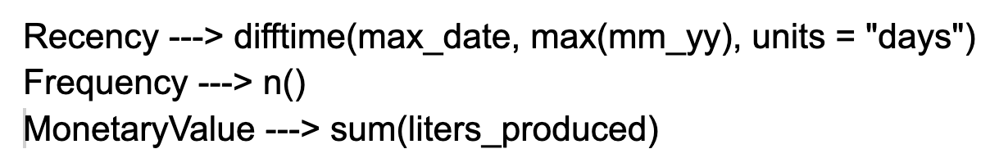
Metric Calculation - RFM
Aggregated meter reading data for 3 years by franchise_id to derive three key metrics: Recency, Frequency, and Monetary Value (RFM)
Recency represents the temporal difference between the latest date and the present days, expressed in days
Frequency represents the production counts
Monetary Value is the total liters produced

Slide 15
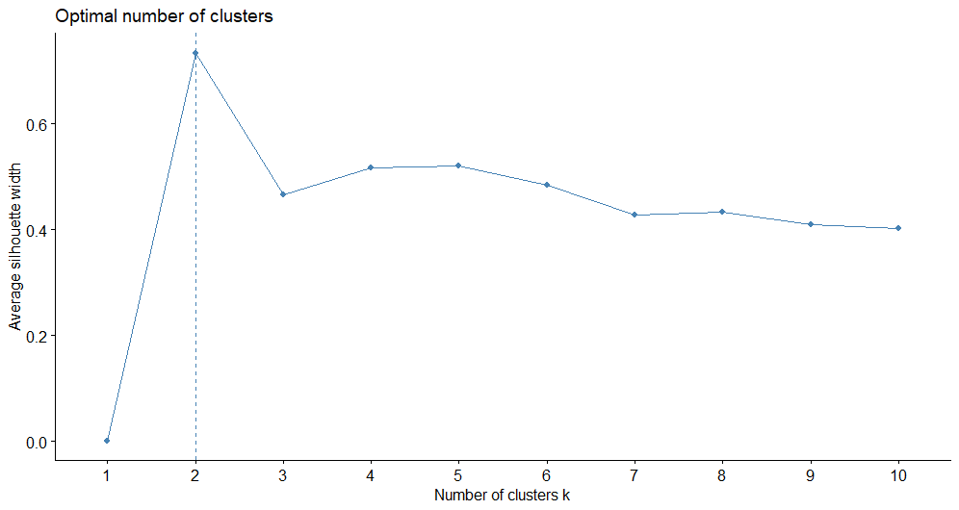
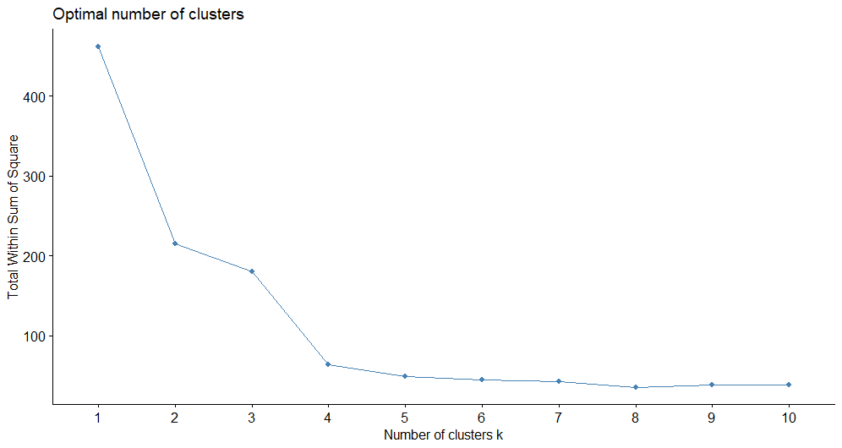
Customer Profiling
Determined the optimal number of clusters using silhouette scores and Within-cluster Sum of Squares
K-means segmented Customers into eight distinct segments based on RFM data revealing distinctive attributes through computation of cluster centers for precise marketing

Slide 16
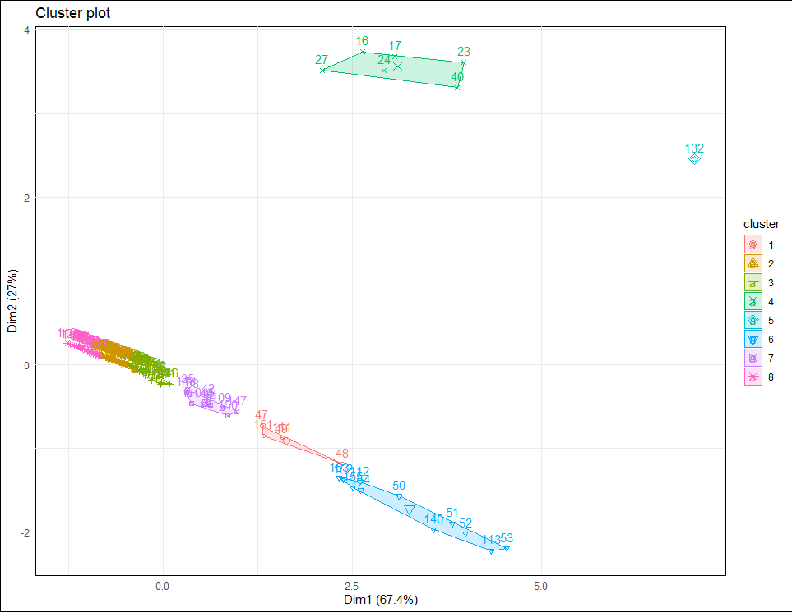
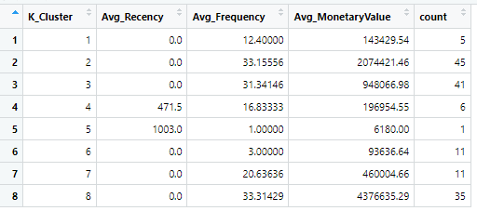
Cluster Analysis
Cluster 8 and 2 are high-value customers that are loyal patron to Jibu
This segmentation enables targeted marketing, personalized experiences, and optimized resource allocation to maximize customer satisfaction and loyalty

Slide 17
Customer Lifetime Value Calculation
Calculated CLV factoring in customer lifespan and a discount rate to account for the time value of money over a three-year horizon
A discount rate of 10% per year is applied to ensure future cash flows are inherently less valuable than present cash flows
Liters produced: Represents the quantity of water (in liters) produced by the franchise in one year
Discount Rate: Discount Rate of 10%
Year: The number of years since the start date

Slide 18
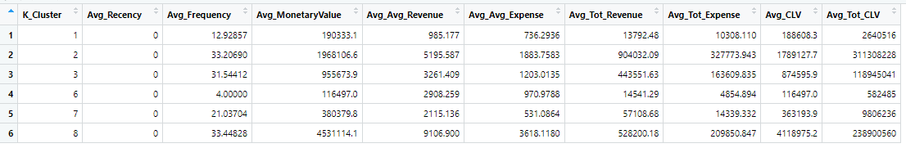
Mapping Clusters to CLV
Mapped CLV data with cluster data to compare CLV metrics across different franchise clusters, assessing variations in franchise value and performance
Identified clusters with higher CLV, indicating areas of strength, and clusters with lower CLV, signaling areas for improvement

Slide 19
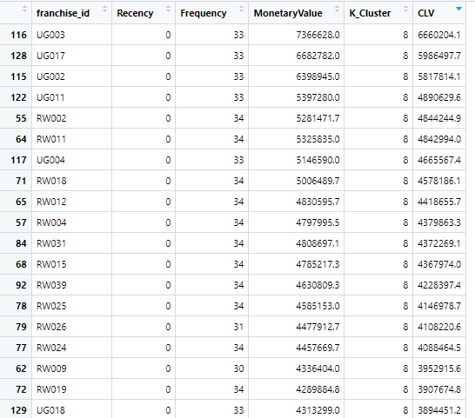
Mapping CLV to Health Data
The CLV data was mapped with the health data to compute the Average CLV and total CLV
Franchise from Uganda and Rwanda shows high CLV compared to Kenya and Goma

Slide 20
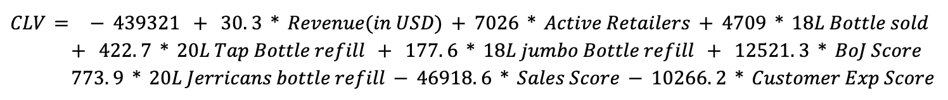
Regression Analysis
A predictive model was developed to forecast future CLV trends based on Revenue, Active Retailers, Sales Score, bottles sold to anticipate franchise outcomes
The regression analysis revealed key predictors of CLV, highlighting the importance of BoJ Score and Sales Score, which directly impact customer satisfaction and loyalty
The built regression model achieved an R-square value of ~86% (Figure-3.7), demonstrating that a substantial proportion of the variance in the CLV

Slide 21
Competitor Analysis
Naivas (Kenya): Boasts a broad product range. Jibu could counter this by expanding its own product offerings and enhancing its distribution network.
Strategy: Jibu can launch a loyalty program for customers and host educational workshops on water conservation.
Virunga (Rwanda): Commits to eco-friendly packaging. Jibu could adopt similar practices and seek sustainability partnerships to bolster its eco-credentials.
Strategy: tree-planting events and water stations in high traffic areas can promote and show eco-friendliness.
Swissta (Goma): Focuses on high-quality products. Jibu should ensure rigorous quality control and consider broadening its product lines.
Strategy: free water testing and event sponsorships community engagement.
Aqua Sipi (Uganda): Known for premium water quality. Jibu might distinguish itself by emphasizing its social impact and extending its reach.
Strategy: Investing in mobile water purification units or Jibu Trucks to provide emergency relief and humanitarian aid during natural disasters or public health crises

Slide 22
Conclusions & Recommendations
Segmented Campaigns: Craft distinct marketing campaigns for potential franchise owners and consumers, addressing their unique interests
Cultural Resonance: Tailor marketing to reflect local cultural practices and languages to better connect with the community
Digital Strategy: Engage customers through social media and online advertising, using data to personalize the approach
Franchise Council: Form a council of leading franchisees to offer business insights and promote collaborative decision-making
Skills Workshops: Provide ongoing training to franchisees in business management and customer service
Recognition Programs: Launch programs to honor and incentivize franchisees' sales and service achievements
Surveyor Training: Educate surveyors to enhance data collection quality, leading to more informed business decisions
Agile Monitoring: Monitor performance metrics closely and adjust strategies swiftly in response to market changes

Slide 23
Thank you!

